Slide 1
DAY 2
Assignments and Exercises from Day1
Python Handson - Numpy, pandas and scikit learn
Using Python for machine learning
Assignments and Exercises

Slide 2
Assignments and Exercises from Day1

Slide 3
Python Handson - Numpy, pandas, pickle, joblib and scikit learn
from sklearn import svm
from sklearn import datasets
clf = svm.SVC()
iris = datasets.load_iris()
X, y = iris.data, iris.target
clf.fit(X, y)
import pickle
s = pickle.dumps(clf)
clf2 = pickle.loads(s)
clf2.predict(X[0:1])
y[0]
from sklearn.externals import joblib
joblib.dump(clf, 'filename.pkl')
clf = joblib.load('filename.pkl')
import numpy as np
import pandas as pd
from sklearn.datasets import load_iris
# save load_iris() sklearn dataset to iris
# if you'd like to check dataset type use: type(load_iris())
# if you'd like to view list of attributes use: dir(load_iris())
iris = load_iris()
# np.c_ is the numpy concatenate function
# which is used to concat iris['data'] and iris['target'] arrays
# for pandas column argument: concat iris['feature_names'] list
# and string list (in this case one string); you can make this anything you'd like..
# the original dataset would probably call this ['Species']
data1 = pd.DataFrame(data= np.c_[iris['data'], iris['target']],
columns= iris['feature_names'] + ['target'])

Slide 4
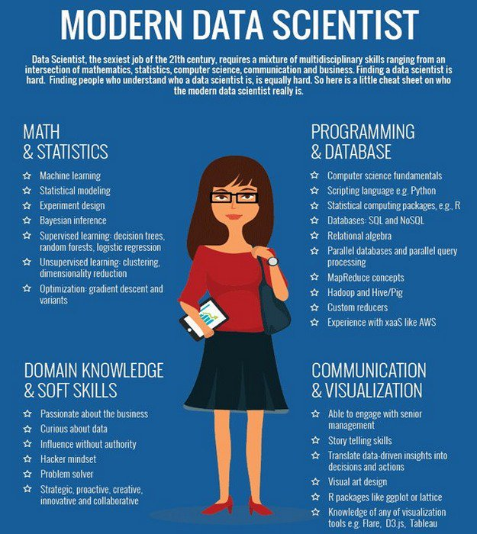
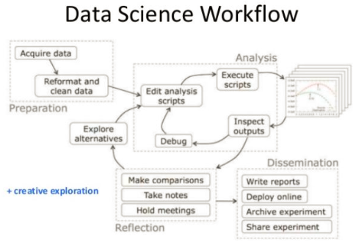
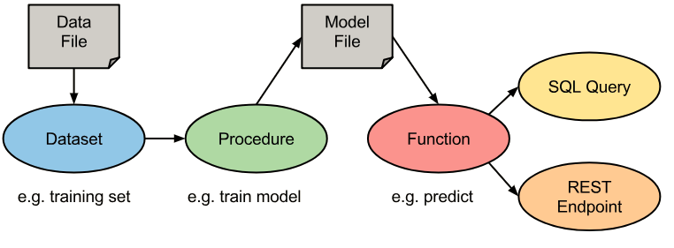
Using Python for machine learning

Slide 5
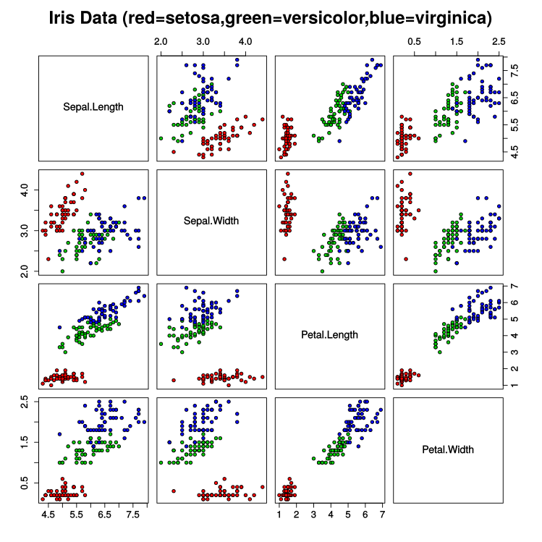
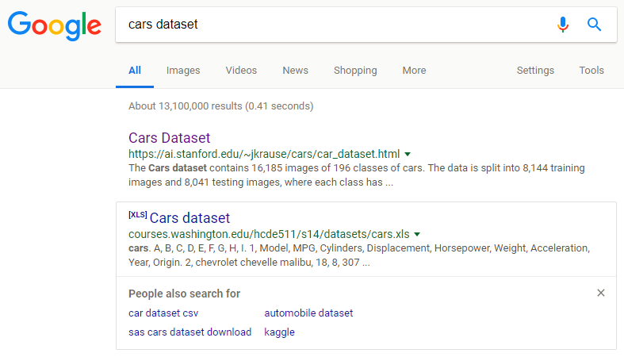
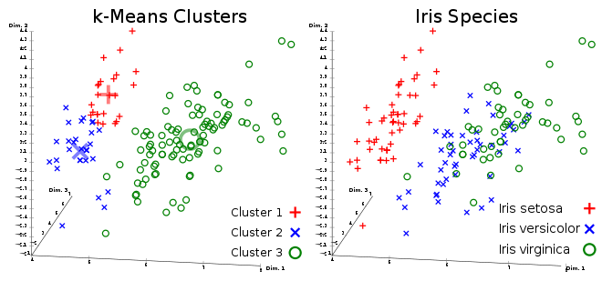
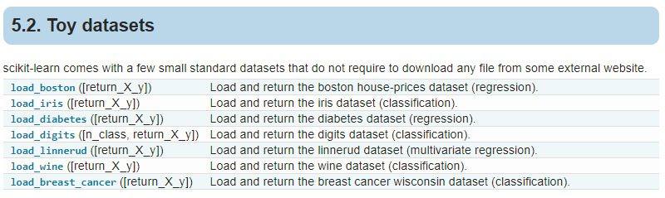
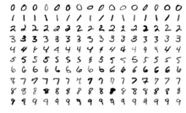
Datasets
Iris – flower dataset
Cars
MNIST - Modified National Institute of Standards and Technology database
Notes:
https://en.wikipedia.org/wiki/List_of_datasets_for_machine_learning_research
http://scikit-learn.org/stable/datasets/index.html

Slide 6
How to import datasets
For small data, pandas.read_csv is the way to go.
For "medium" data, use dask.read_csv
And for big data, use spark.read.csv
Import pandas as pd
from sklearn import datasets
iris = datasets.load_iris()
X, y = iris.data, iris.target
from sklearn.datasets import load_iris
iris = load_iris()
data1 = pd.DataFrame(data= np.c_[iris['data'], iris['target']],
columns= iris['feature_names'] + ['target'])
x = datasets.load_boston()
data1 = pd.DataFrame(data= np.c_[x['data'], x['target']],
columns= list(x['feature_names']) + ['target'])
import pandas as pd
url="https://raw.githubusercontent.com/cs109/2014_data/master/countries.csv"
c=pd.read_csv(url)
c.head()
from io import StringIO
import pandas as pd
import requests
url='https://raw.githubusercontent.com/cs109/2014_data/master/countries.csv'
s=requests.get(url).text
c=pd.read_csv(StringIO(s))
Notes:
https://docs.scipy.org/doc/numpy/reference/arrays.dtypes.html

Slide 7
Importance of cleaning up datasets

Slide 8

Which model to chose

Slide 9
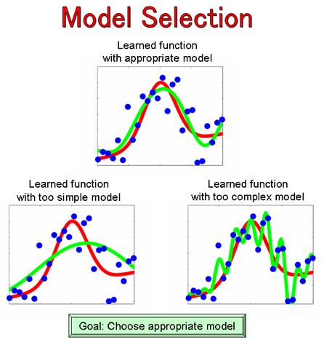
Why should we select the right model?

Slide 10
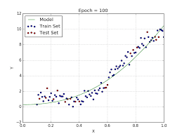
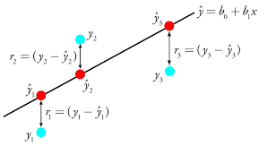
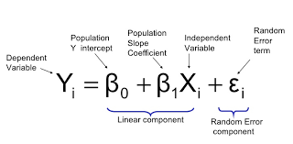
Linear Regression
#Import Library
#Import other necessary libraries like pandas, numpy...
from sklearn import linear_model
#Load Train and Test datasets
x_train=input_variables_values_training_datasets
y_train=target_variables_values_training_datasets
x_test=input_variables_values_test_datasets
# Create linear regression object
linear = linear_model.LinearRegression()
# Train the model using the training sets and check score
linear.fit(x_train, y_train)
linear.score(x_train, y_train)
#Equation coefficient and Intercept
print('Coefficient: \n', linear.coef_)
print('Intercept: \n', linear.intercept_)
#Predict Output
predicted= linear.predict(x_test)
It is used to estimate real values based on continuous variables. Here, we establish relationship between independent and dependent variables by fitting a best line. This best fit line is known as regression line and represented by a linear equation Y= a *X + b.
In this equation:
Y – Dependent Variable
a – Slope
X – Independent variable
b – Intercept

Slide 11
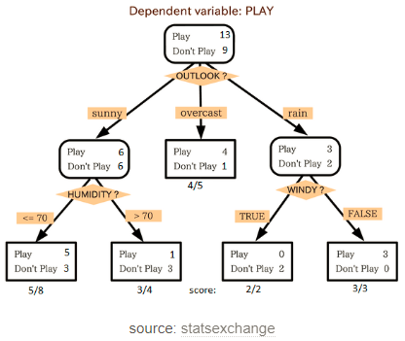
Decision Tree
It is a type of supervised learning algorithm that is mostly used for classification problems. It works for both categorical and continuous dependent variables. In this algorithm, we split the population into two or more homogeneous sets. This is done based on most significant attributes/ independent variables to make as distinct groups as possible.
In the image, you can see that population is classified into four different groups based on multiple attributes to identify ‘if they will play or not’. To split the population into different heterogeneous groups, it uses various techniques like Gini, Information Gain, Chi-square, entropy.
#Import Library
#Import other necessary libraries like pandas, numpy...
from sklearn import tree
#Assumed you have, X (predictor) and Y (target) for training data set and x_test(predictor) of test_dataset
# Create tree object
model = tree.DecisionTreeClassifier(criterion='gini') # for classification, here you can change the algorithm as gini or entropy (information gain) by default it is gini
# model = tree.DecisionTreeRegressor() for regression
# Train the model using the training sets and check score
model.fit(X, y)
model.score(X, y)
#Predict Output
predicted= model.predict(x_test)

Slide 12
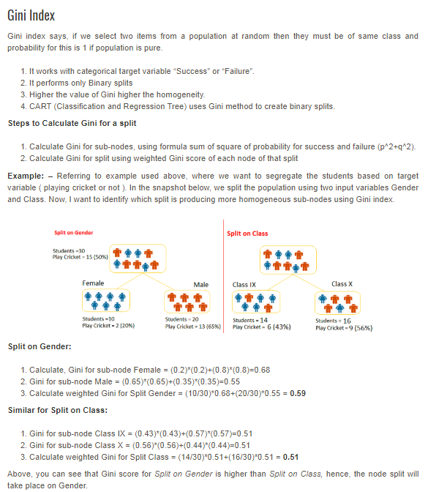
What is Gini index?

Slide 13
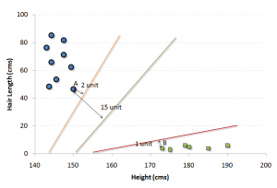
SVM (Support Vector Machine)
It is a classification method. In this algorithm, we plot each data item as a point in n-dimensional space (where n is number of features you have) with the value of each feature being the value of a particular coordinate.
For example, if we only had two features like Height and Hair length of an individual, we’d first plot these two variables in two dimensional space where each point has two co-ordinates (these co-ordinates are known as Support Vectors).
Next, we will find some line that splits the data between the two differently classified groups of data. This will be the line such that the distances from the closest point in each of the two groups will be farthest away.
#Import Library
from sklearn import svm
#Assumed you have, X (predictor) and Y (target) for training data set and x_test(predictor) of test_dataset
# Create SVM classification object
model = svm.svc() # there is various option associated with it, this is simple for classification.
# Train the model using the training sets and check score
model.fit(X, y)
model.score(X, y)
#Predict Output
predicted= model.predict(x_test)

Slide 14
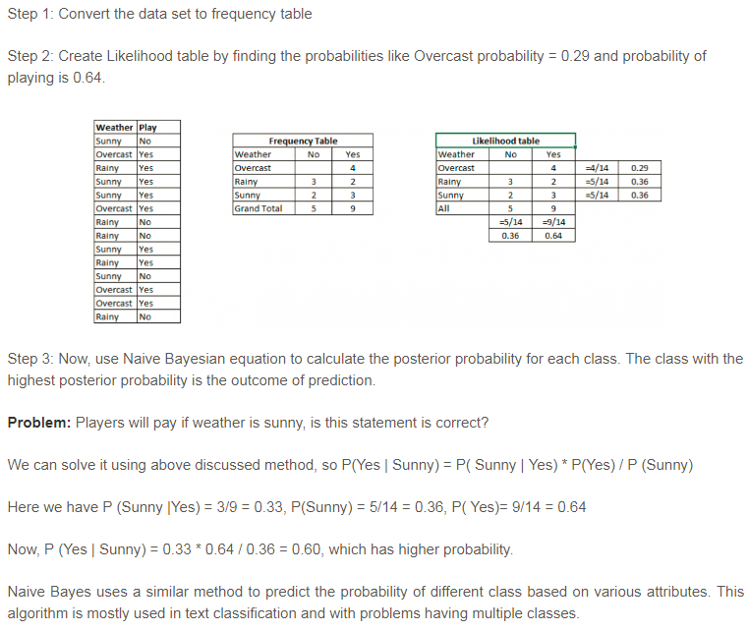
Naive Bayes
#Import Library
from sklearn.naive_bayes import GaussianNB
#Assumed you have, X (predictor) and Y (target) for training data set and x_test(predictor) of test_dataset
# Create SVM classification object
model = GaussianNB() # there is other distribution for multinomial classes like Bernoulli Naive Bayes
# Train the model using the training sets and check score
model.fit(X, y)
#Predict Output
predicted= model.predict(x_test)
It is a classification technique based on Bayes’ theorem with an assumption of independence between predictors. In simple terms, a Naive Bayes classifier assumes that the presence of a particular feature in a class is unrelated to the presence of any other feature.

Slide 15
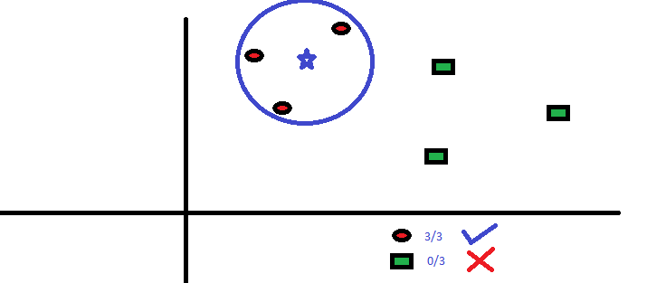
kNN (k- Nearest Neighbors)
#Import Library
from sklearn.neighbors import KNeighborsClassifier
#Assumed you have, X (predictor) and Y (target) for training data set and x_test(predictor) of test_dataset
# Create KNeighbors classifier object
model = KNeighborsClassifier(n_neighbors=6) # default value for n_neighbors is 5
# Train the model using the training sets and check score
model.fit(X, y)
#Predict Output
predicted= model.predict(x_test)
It can be used for both classification and regression problems. However, it is more widely used in classification problems in the industry. K nearest neighbors is a simple algorithm that stores all available cases and classifies new cases by a majority vote of its k neighbors. The case being assigned to the class is most common amongst its K nearest neighbors measured by a distance function.
These distance functions can be Euclidean, Manhattan, Minkowski and Hamming distance.

Slide 16
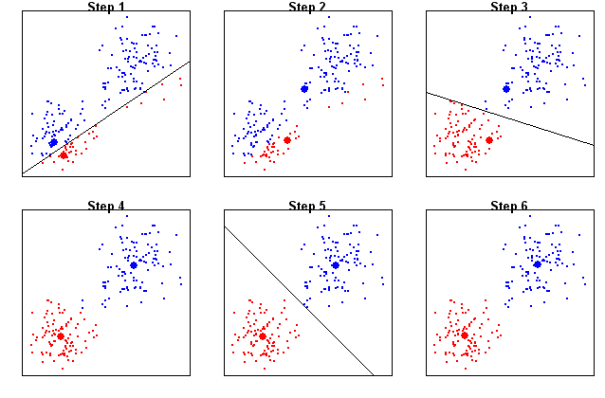
K-Means
K-means picks k number of points for each cluster known as centroids.
Each data point forms a cluster with the closest centroids i.e. k clusters.
Finds the centroid of each cluster based on existing cluster members. Here we have new centroids.
As we have new centroids, repeat step 2 and 3. Find the closest distance for each data point from new centroids and get associated with new k-clusters. Repeat this process until convergence occurs i.e. centroids does not change
#Import Library
from sklearn.cluster import KMeans
#Assumed you have, X (attributes) for training data set and x_test(attributes) of test_dataset
# Create KNeighbors classifier object model
k_means = KMeans(n_clusters=3, random_state=0)
# Train the model using the training sets and check score
model.fit(X)
#Predict Output
predicted= model.predict(x_test)

Slide 17
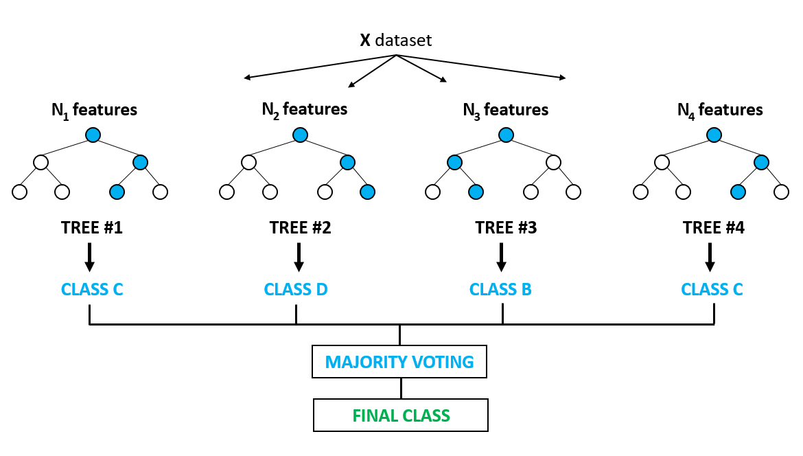
Random Forest
Random Forest is a trademark term for an ensemble of decision trees. In Random Forest, we’ve collection of decision trees (so known as “Forest”). To classify a new object based on attributes, each tree gives a classification and we say the tree “votes” for that class. The forest chooses the classification having the most votes (over all the trees in the forest).
Each tree is planted & grown as follows:
If the number of cases in the training set is N, then sample of N cases is taken at random but with replacement. This sample will be the training set for growing the tree.
If there are M input variables, a number m<<M is specified such that at each node, m variables are selected at random out of the M and the best split on these m is used to split the node. The value of m is held constant during the forest growing.
Each tree is grown to the largest extent possible. There is no pruning.
#Import Library
from sklearn.ensemble import RandomForestClassifier
#Assumed you have, X (predictor) and Y (target) for training data set and x_test(predictor) of test_dataset
# Create Random Forest object
model= RandomForestClassifier()
# Train the model using the training sets and check score
model.fit(X, y)
#Predict Output
predicted= model.predict(x_test)

Slide 18
Assignments and Exercises

